Slide 1

Know Myself
Know My Spouse
Know God’s Family
Glorify God

Slide 2
What is First Year?

Slide 3
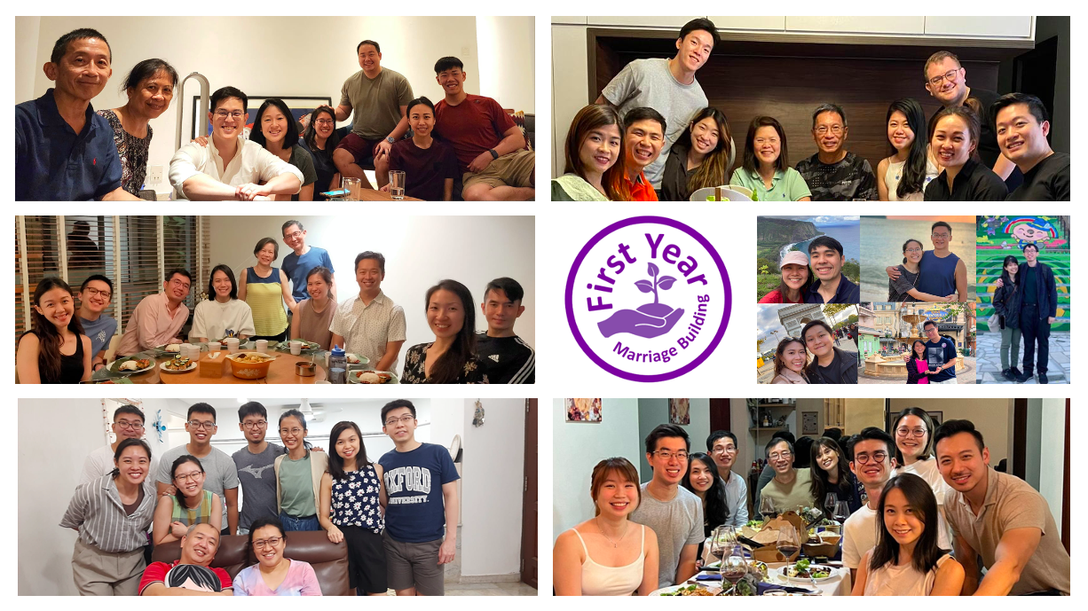

Slide 4
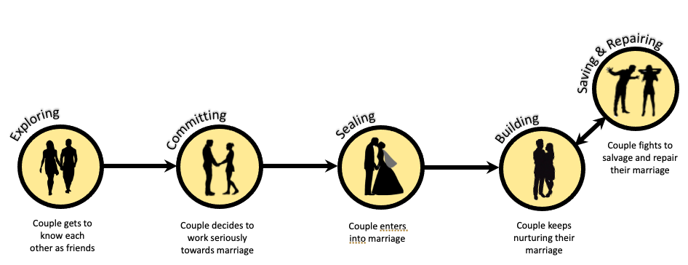

Slide 5
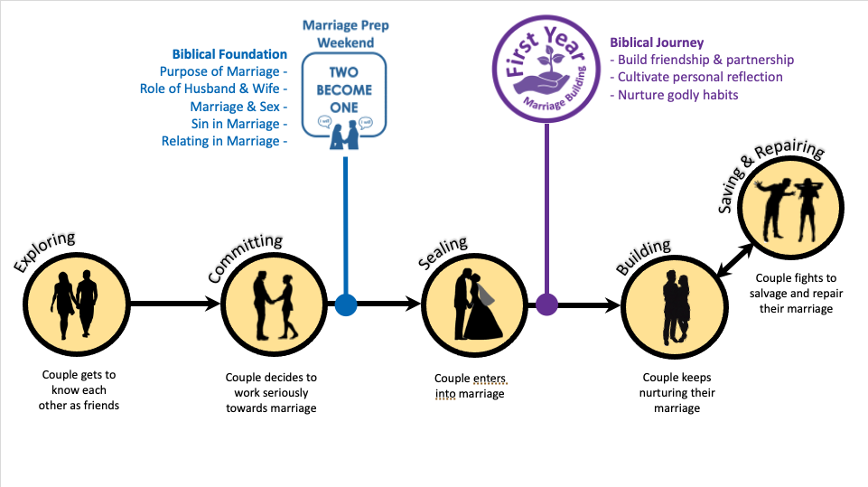
“God’s act is instantaneous. God’s work is a process.”

Slide 6


Slide 7
Your Marriage Builders

Slide 8
“Our Lord Jesus Christ said: ‘At the beginning, the Creator God made them male and female’. Quoting Genesis, Jesus continued, ‘For this reason a man will leave his father and mother and be united to his wife, and the two will become one flesh.’ Jesus concluded, ‘so they are no longer two, but one flesh. Therefore what God has joined together, let no one separate.’”

Slide 9
“God’s Word teaches that marriage is not a human invention. It is instituted by God, designed by Him to illustrate His faithful love for His people, and the union between Christ and His Church. It is not to be undertaken lightly, but reverently in the fear of God, for the extension of His Kingdom.”

Slide 10
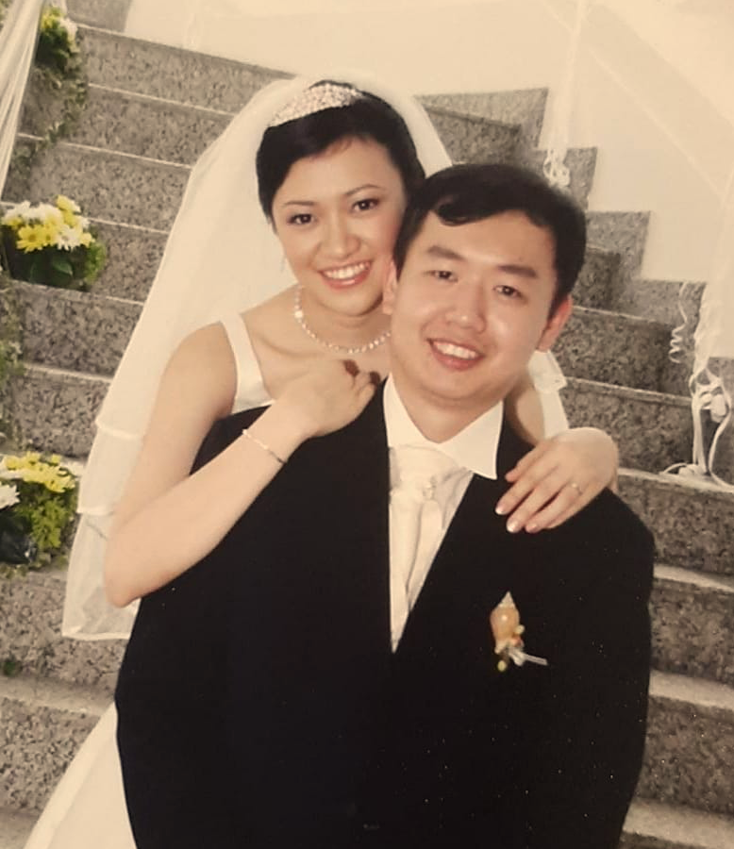
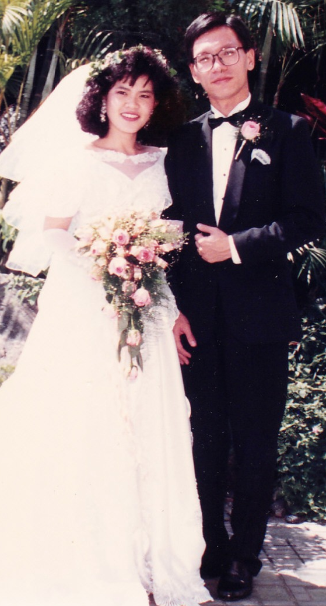


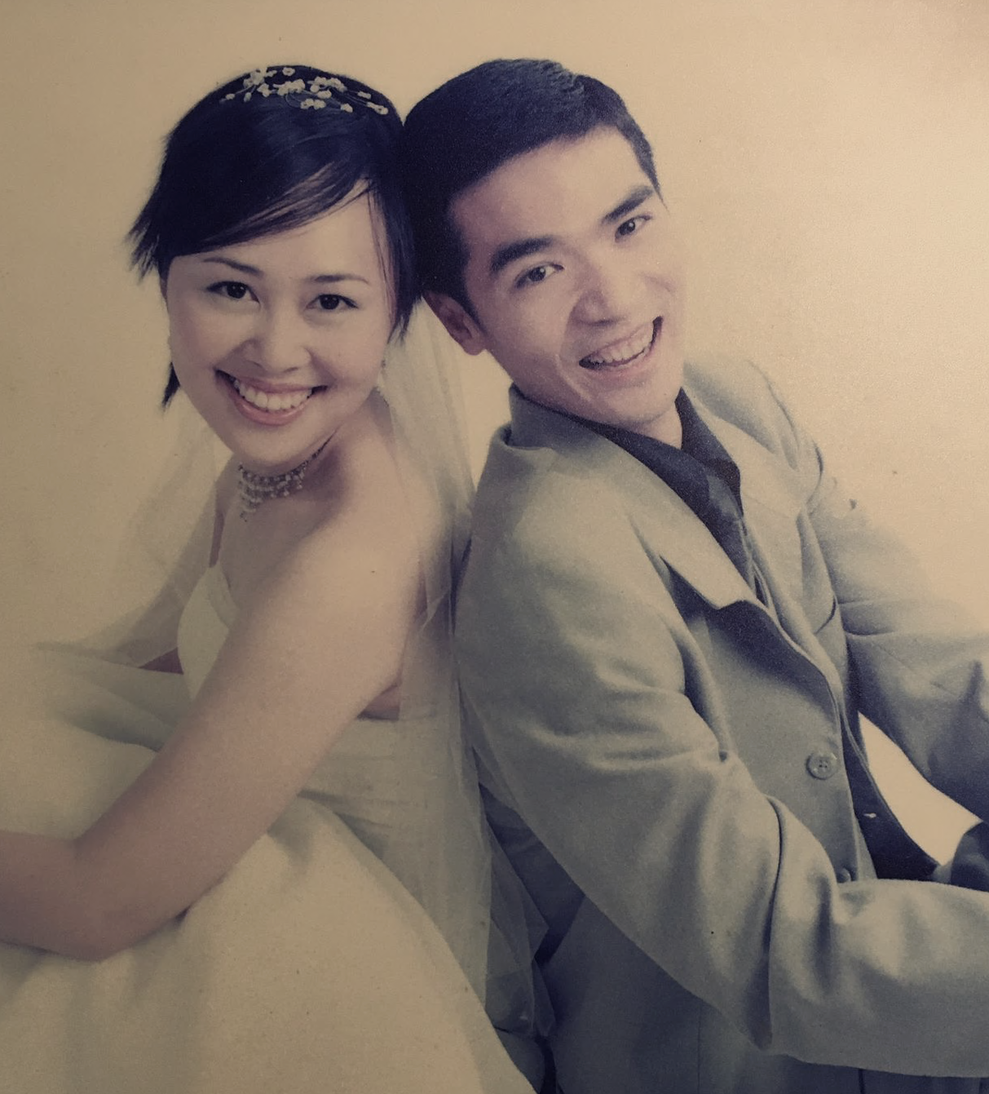


Kept their Vows 31yrs
Kept their Vows 18yrs
Kept their Vows 33yrs
Kept their Vows 36yrs
Kept their Vows 39yrs
Kept their Vows 18yrs

Slide 11
What to Expect in the 5 Sessions

Slide 12
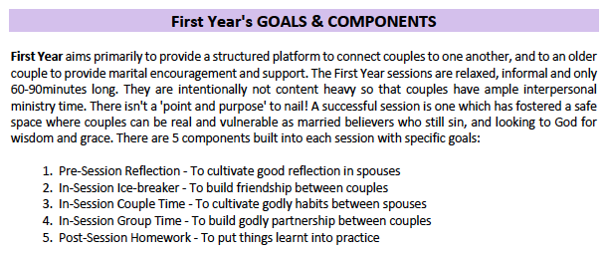

Slide 13
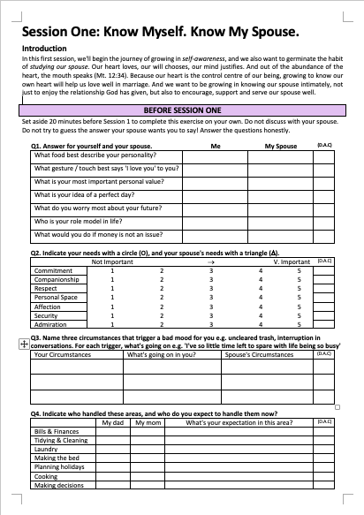
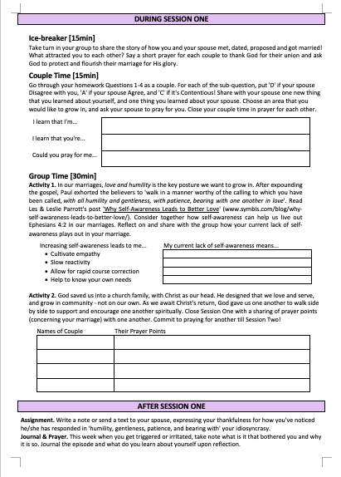
What to Expect in the 5 Sessions
In-Session Ice-breaker
To build friendship between couples
Pre-Session Reflection
To cultivate good reflection in spouses
In-Session Group Time
To build godly partnership between couples
Pre-Session &
In-Session Couple Time
To cultivate godly habits between spouses
Post-Session Homework To put things learnt into practice

Slide 14
What to Expect in the 5 Sessions
Know Myself
Know My Spouse
Know God’s Family
Glorify God

Slide 15
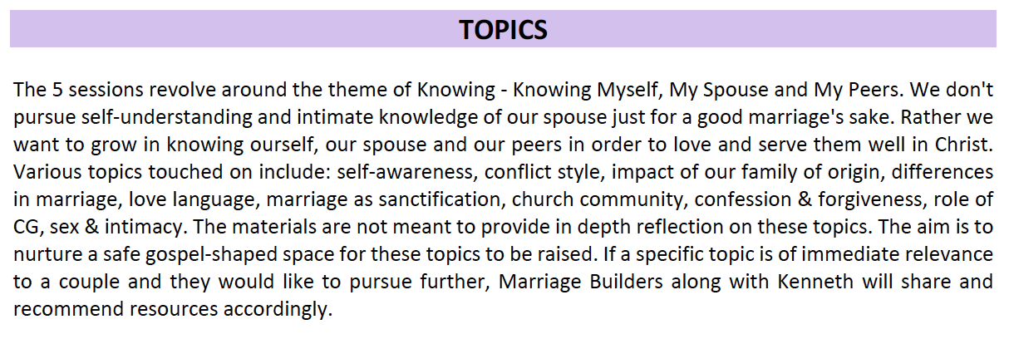
Know Myself
Know My Spouse
Know God’s Family
Glorify God

Slide 16
Tips for a good First Year

Slide 17
#1 Marriage needs hard work!

Slide 18
#2 Prioritize the 5 meetings.
(once a month investment!)

Slide 19
#3 Godly, trusted friendship takes time to nurture.

Slide 20
#4 Don’t assume you
know yourself
or your spouse.

Slide 21
Announcements

Slide 22


First Year Dinner
Jan2024, 730-930PM
Aperia Church Office

Slide 23
Q&A

